Slide 1
Detail Views
30 March 2011
Notes:
Detail Views - <number>
Guidewire training materials contain Guidewire proprietary information that is subject to confidentiality and non-disclosure agreements. You agree to use the information in this manual solely for the purpose of training to implement Guidewire software solutions. You also agree not to disclose the information in this manual to third parties or copy this manual without prior written consent from Guidewire. Guidewire training may be given only by Guidewire employees or certified Guidewire partners under the appropriate agreement with Guidewire.

Slide 2
Lesson objectives
By the end of this lesson, you should be able to:
  Describe the functionality of detail views
  Create new detail views
  Reference detail views from parent containers
  This lesson uses the notes section for additional explanation and information.
  To view the notes in PowerPoint, choose View→Normal or View→Notes Page.
  If you choose to print the notes for the lesson, be sure to select “Print hidden slides.”
Notes:
Detail Views - <number>

Slide 3
Lesson outline
Detail view basics
Creating detail views
Referencing detail views
Notes:
Detail Views - <number>

Slide 4
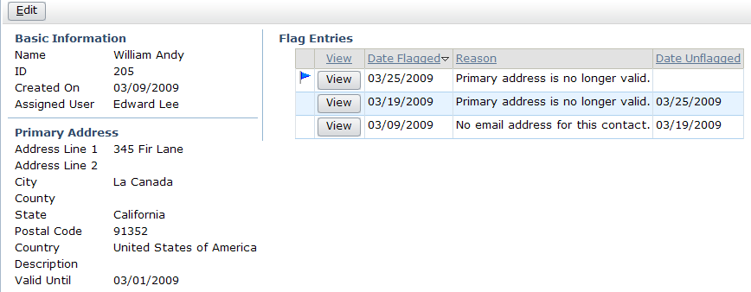
Detail views
ABContactSummaryDV
A detail view is a container widget that typically displays one object and information related to that object
  Users can view and, in some cases, edit that data
Notes:
Detail Views - <number>

Slide 5

Detail view root objects
ABContact
(root object)
ABContactSummaryDV
Container widgets typically have one root object
  Detail view displays information from its root object
  Whenever detail view is referenced, parent container must pass this object to detail view
Notes:
Detail Views - <number>
It is possible to create a detail view that has no root objects. This sort of detail view could display only static labels, system information, or both, however. These types of detail views are therefore uncommon.
There may be multiple root objects, but more commonly a related object is referenced by a foreign key field in the root object.

Slide 6
Detail view structure
toolbar (optional)
first input
column (required)
additional
input columns (optional)
Input columns are stacks of widgets
  Must have one, but can have as many as desired
Notes:
Detail Views - <number>
Detail view toolbars are optional. Detail views typically have toolbars when at least some of the data in the detail view must be editable (and therefore Edit, Update, and Cancel buttons are needed).
Technically, a detail view is not required to have any input columns. A detail view with atomic widgets does need at least one input column, however, and virtually every detail view has atomic widgets.
Guidewire applications automatically put a vertical blue line in between input columns. This line can be seen in the screenshot above in between the two red rectangles.

Slide 7
Detail view contents
input widgets
"layout widgets"
embedded list view
input set
Notes:
Detail Views - <number>
Input widgets are widgets that display (and in some cases let end users edit) one field of data.
"Layout widgets" do not display data, but instead are used to make a detail view more readable and/or user-friendly. The two most commonly used widgets of this sort are:
Label widgets, which display label text.
Input divider widgets, which are rendered as horizontal lines.
Recall that input sets are sets of input widgets that can be reused across multiple detail views (and/or which are used to extend a single instance of visibility or editability logic across multiple widgets).
Detail views can also have list views embedded in them.

Slide 8
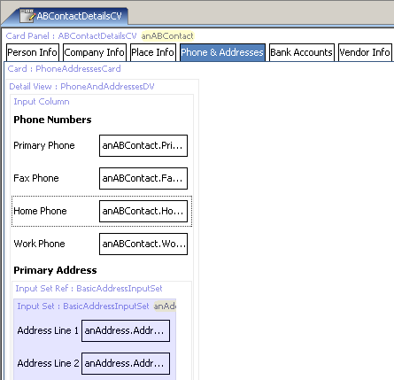
PCF container files are hierarchical
top-level container
child container
Always declares one top-level container
Can declare zero to many child containers
Can reference zero to many containers declared in other PCFs
referenced container
(appears in blue)
Notes:
Detail Views - <number>
In the example above:
The top-level container is ABContactDetailsCV. This container is declared in ABContactDetailsCV.
There is a child container: PhoneAndAddressesDV. This container is declared in ABContactDetailsCV.
There is a referenced container: BasicAddressInputSet. This container is declared in a file other than ABContactDetailsCV. It is declared in BasicAddressInputSet.pcf.
Some location files are also hierarchical. For example, a page contains a screen, which in turn can contain other views. Some location files are not hierarchical. For example, a forward can contain only logic to determine which location to render. The forward does not contain any containers itself.

Slide 9
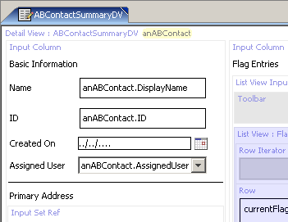
Reusable containers
When container (such as detail view) is declared as top-level, it is reusable
  Other containers can reference (embed) this container
If container is likely to be needed in multiple places, create it in its own PCF file as top-level container
Notes:
Detail Views - <number>
In the example above, ABContactSummaryDV is a top-level container. Other containers can therefore reference it. In TrainingApp, the ABContactSummaryPage.pcf file has a screen which references ABContactSummaryDV.

Slide 10
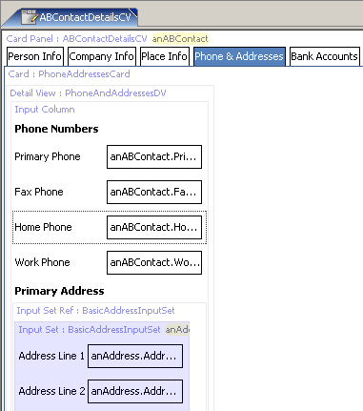
Inline containers
When container (such as detail view) is declared as child container, it is not reusable
  Other containers cannot reference (embed) this container
If container is unlikely to be needed in multiple places, you can create it "inline"
Notes:
Detail Views - <number>
In the example above, PhoneAndAddressesDV is an inline container. It appears in only one place in the application - on the Phone & Addresses card of ABContactDetailsCV.

Slide 11
Lesson outline
Detail view basics
Creating detail views
Referencing detail views
Notes:
Detail Views - <number>

Slide 12
Steps to create detail views
Create the DV file
Specify the required variables
Optionally specify additional properties
Add input columns
Add input widgets
Notes:
Detail Views - <number>
The steps to create an inline detail view are the same as for a reusable detail view, except at the very beginning.
Steps to create inline detail views
Create the DV
Optionally specify additional properties
Add input columns
Add input widgets

Slide 13

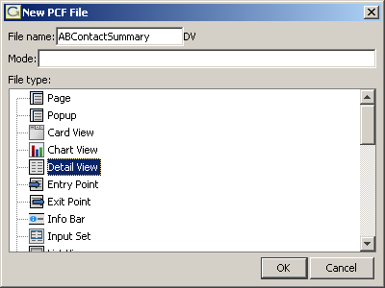
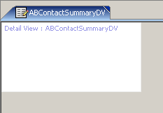
Step 1: Create the DV file
"DV" automatically appended to end
of file name
Notes:
Detail Views - <number>
Do the following to create a PCF file that defines a detail view:
In Studio's PCF editor, right-click the folder in which the detail view file should be stored. Select New > PCF file.
Name the file and select "Detail View" for the file type. Studio automatically adds "DV" to the end of the file name. If you manually add "DV" to the end of the file name, Studio ignores it, so it is not possible to inadvertently name a file that ends in "DVDV".
Click OK.
Studio displays the new detail view. At the top of the canvas, there is a link named "Detail View : <nameOfDetailView>. Otherwise, the file is empty.
Inline detail views
To create an inline detail view, find the "Detail View" tool in the PCF editor toolbox. Drag the detail view widget onto an existing screen, listdetail view, or card view.

Slide 14
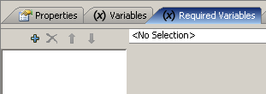
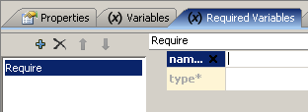
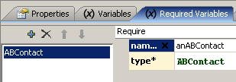
Step 2: Specify the required variable(s)
Root objects declared on detail view's Required Variables tab
  To display tab, click "Detail View : <name>" link
  For each required root object, click "+" and specify object's name and data type
widgets in detail view reference this object using this name
Notes:
Detail Views - <number>
Recall that virtually every detail view has one or more root objects. These root objects must be specified on the detail view's Required Variables tab.
To display the detail view's various property tabs, click the link at the top of the detail view file labeled "Detail View : <nameOfDetailView>".
To create a root object / required variable:
Click the Required Variables tab.
Click the "+".
Specify the object's name. This is how widgets in the detail view will reference the object.
Specify the object's data type.
Inline detail views
You do not need to specify root objects for inline detail views. Because an inline detail view can have only one parent, it automatically inherits the root objects of its parent.

Slide 15
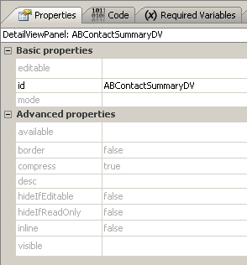
Step 3: Optionally specify additional properties
By default, all container widgets are:
  Editable
  Visible
Notes:
Detail Views - <number>
There are two states that a detail view can be in: edit mode and read-only mode. If the editable property for a detail view is true (or blank, which defaults to true), then the detail view can be put into either read-only mode or edit mode. If the editable property for a detail view is false, then the detail view cannot be put into edit mode. It is always in read-only mode.
Inline detail views
This step is the same for reusable and inline detail views.

Slide 16
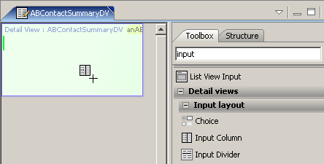
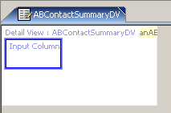
Step 4: Add input columns
Notes:
Detail Views - <number>
To add an input column, locate the input column tool in the toolbox and drag it onto the canvas. If there are already input columns, dark green bars identify where the new input column could be placed, and a light green bar indicates the current place the new input column will be located.
You can skip this step by dragging an input widget onto the canvas. Studio automatically adds an input column around it if it is the first widget in the stack. It may be easier for developers who are new to PCF configuration to manually drag input columns onto the canvas to ensure that the structure of the detail view is correct, however.
Inline detail views
This step is the same for reusable and inline detail views.

Slide 17
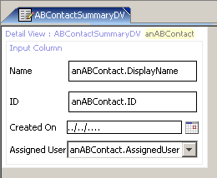
Step 5: Add input widgets
Input widget creation is discussed in "Atomic Widgets" lesson
Input widgets must reference object as named on Required Variables tab
Notes:
Detail Views - <number>
Notice that the input widgets in the screenshot above reference the ABContact object as "anABContact". This is because the root object is declared on the Required Variables tab as "anABContact". If the object had been named "currentABContact", then the Name widget would need to be bound to "currentABContact.DisplayName".
Inline detail views
This step is the same for reusable and inline detail views, except that the detail view inherits its root objects from the parent container, and therefore the widgets must match the object as named in the parent container.

Slide 18
List views and input sets
embedded list view
input set
Input sets covered in "Input Sets" lesson
List views covered in "List Views" lesson
Notes:
Detail Views - <number>

Slide 19
Lesson outline
Detail view basics
Creating detail views
Referencing detail views
Notes:
Detail Views - <number>

Slide 20

Reference widgets
A reference widget is used in a parent container to embed a child container inside the parent
Several types of reference widgets in PCF architecture
  Panel refs embed:
    Detail views
    List views
    Card panels
    Listdetail views
  List view inputs embed:
    List views in detail views
Screen
reference
widget
Detail view
Notes:
Detail Views - <number>

Slide 21
What can contain a detail view?
screen
a top-level container
one can navigate to
Screen
secondary views
collections of primary views organized for usability
Card View / ListDetail View
primary views
a single object (and its related data) or set of objects
Detail
View
List
View
Input Sets
atomic widgets
individual elements of data and/or functionality
Atomic Widgets
Notes:
Detail Views - <number>

Slide 22
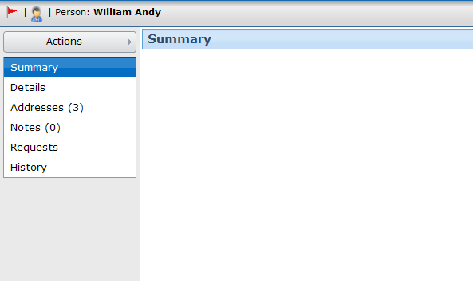
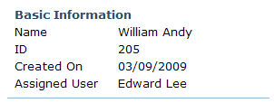
Steps to reference detail views
Step 1: Create panel ref widget
Step 2: Specify properties
Step 3: Reload the metadata
screen
ABContact
SummaryDV
Notes:
Detail Views - <number>
Inline detail views
For an inline detail view, referencing does not occur. The only required step is to reload the metadata.

Slide 23
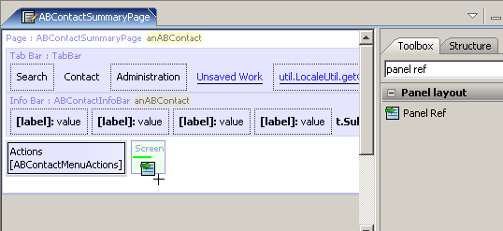
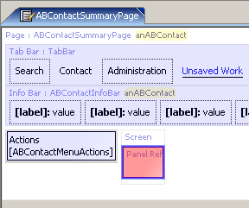
Step 1: Create panel ref widget
Notes:
Detail Views - <number>
The screenshot above shows the ABContactSummaryPage file before the detail view has been added. Notice that at the top of the file you can see two rows of widgets in a light blue shading. The first row corresponds to the tab bar (which is declared in TabBar.pcf). The second row corresponds to the widgets in the ABContact location group's info bar (which is declared in ABContactInfoBar.pcf). Finally, below the left part of the info bar, there is a third light blue shaded area corresponding to the actions menu.
Before the detail view is added to the ABContactSummaryPage file, the screen widget is empty.
Once the panel ref is added to the screen, Studio initially displays the panel ref with red shading. This is because you have not yet specified which detail view the panel ref should reference.

Slide 24
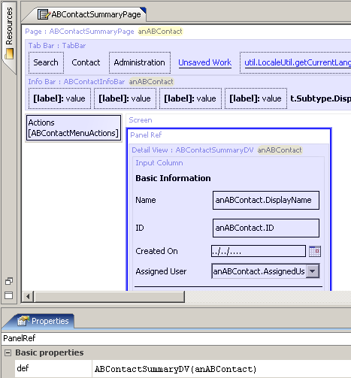

Step 2: Specify properties
def property identifies:
  Name of detail view to reference
  Object to pass to detail view for it to use as root objects
Notes:
Detail Views - <number>
The ABContactSummaryDV detail view has one root object (required variable), which must be of type ABContact. Any panel ref that references ABContactSummaryDV must therefore pass an ABContact object to it.
If the detail view had two or more root objects, then the panel ref would need to pass two or more objects. The order of the objects as listed in the panel ref's def property must match the order in which the objects are declared on the Required Variables tab.
When one container references another, the PanelRef tag must include one object for every required variable in the child container, and the object(s) passed from the parent container must be of the correct type. But there is no requirement that they have the same name as the variable names in the child container. For example, the ABContactSummaryDV detail view shown in the previous slides has one required variable whose name is "anABContact" and whose type is ABContact. Any container that references ABContactSummaryDV must pass one ABContact object in the PanelRef tag, but the object could have any name, such as "anABContact", "externalContact", or "billingContact".

Slide 25

Studio convention for child containers
Child containers appear with light blue shade
  Double-clicking opens referenced file
double-click
Notes:
Detail Views - <number>
When viewing a container file in Studio, if it references a child container and the child container also references a child container, then the "grandchild" container appears in a dark blue shade. In other words:
Light blue shading denotes a child container.
Dark blue shading denotes a grandchild container.
You can open any referenced file, regardless of whether it's a child or grandchild file, by double-clicking it.

Slide 26
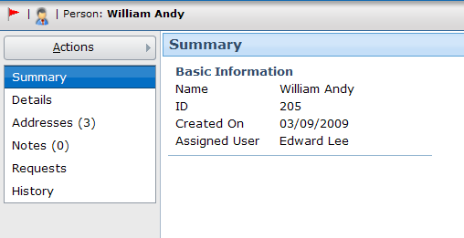
Step 3: Reload the metadata
Deploy UI changes by entering
ALT + SHIFT + L
ALT + SHIFT + L
Notes:
Detail Views - <number>

Slide 27
Detail views in read-only mode
By default, there is no way to put detail view into edit mode
  Next lesson discusses how to add Edit/Update buttons so that data can be modified
Notes:
Detail Views - <number>

Slide 28
Lesson objectives review
You should now be able to:
  Describe the functionality of detail views
  Create new detail views
  Reference detail views from parent containers
Notes:
Detail Views - <number>

Slide 29
Review questions
A detail view that displays data must have at least one root object. Why?
A detail view that displays data must have at least one input column. Why?
What are the two most common types of widgets used to lay out a detail view so that it is more usable to end users?
What determines if a detail view is reusable or not?
The def property of a panel ref usually has a value in the format of "x(y)". What information comes before the parenthesis? (What is the x?) What information is defined within the parenthesis? (What is the y?)
Notes:
Detail Views - <number>
Answers
1. The input widgets of a detail view must reference some object in order to specify where the data they display comes from. This object must be the root object, or an object related to the root object. Therefore, in order to display data, a root object is needed.
2. Input columns are used to layout a detail view. Every input widget must be in an input column. If a detail view displays data, then it has at least one input widget, which means it must have at least one input column.
3. Label and input divider
4. If a detail view is declared as the parent object of a PCF file, then it is reusable. It can be referenced by any number of other containers.
5. The x is the name of the container to embed. The y is a list of objects to pass to the child container to use as root objects.

Slide 30
Notices
Copyright © 2001-2011 Guidewire Software, Inc. All Rights Reserved.
Guidewire, Guidewire Software, Guidewire ClaimCenter, Guidewire PolicyCenter, Guidewire BillingCenter, Guidewire Reinsurance Management, Guidewire ContactManager, Guidewire Vendor Data Management, Guidewire Client Data Management, Guidewire InsuranceSuite, Guidewire ContactCenter, Guidewire Studio, Gosu, Deliver Insurance Your Way, and the Guidewire logo are trademarks or registered trademarks of Guidewire Software, Inc. in the United States and/or other countries.
This material is Guidewire proprietary and confidential. The contents of this material, including product architecture details and APIs, are considered confidential and are fully protected by customer licensing confidentiality agreements and signed Non-Disclosure Agreements (NDAs).
This file and the contents herein are the property of Guidewire Software, Inc. Use of this course material is restricted to students officially registered in this specific Guidewire-instructed course, or for other use expressly authorized by Guidewire. Replication or distribution of this course material in electronic, paper, or other format is prohibited without express permission from Guidewire.
    Guidewire products are protected by one or more of the following patents: U.S. Patent No. 7,885,831; U.S. Patent No. 7,788,296.
Notes:
Detail Views - <number>

